Slide 1
Technical Design
Pure Claims

Slide 2
Basics
Manages Claims for insured Parties, this where S4B ends.
Maintains Reserves for each Claim
Manages Payments through the Claim
Handles Recovery from Third Parties
Recovers other losses through Salvage
Tracks exposure through Reinsurance

Slide 3
Database Structure
Claim_Peril
Claim_Folder
Insurance_File
claim_id
claim_folder_id
policy_id = insurance_file_cnt
Recovery
claim_id
Claim
GIS_Policy_Link
GIS Data Model
claim_id
claim_id
Reserve
claim_id
claim_id
claim_id
Claim_Payment
Claim_Receipt
Claim_RI_Arrangement
claim_payment_id
claim_receipt_id
claim_ri_arrangement_id
Claim_Payment_Item
Claim_Receipt_Item
Claim_RI_Arrangement_Line

Slide 4
Pre-1.8.11 Work Tables
Prior to 1.8.11 all tables in the Database Structure had an identical Work_ prefixed equivalent
When a Claim opened all work was performed in the Work table and if cancelled would be deleted.
When committed all Work table information was copied to the main tables.

Slide 5
Claim Versioning
Introduced in 1.8.11
Each action following an Open Claim duplicates the entire Claim data structure and Claim Builder information.
Maintain Claim
Pay Claim
Claim Recovery
Claim Salvage
A base_claim_id field on Claim points to the first version Claim and groups all versions together.

Slide 6
Generic Peril vs Claims Builder
By default Claims can be set up with Generic Peril which is basic editing interface. A small amount of configuration can be done on these forms.
Claims Builder, enabled by a hidden option, works in the same way as Product Builder with special fields for Reserves and Payments. The screens must contain these controls to make it work.

Slide 7
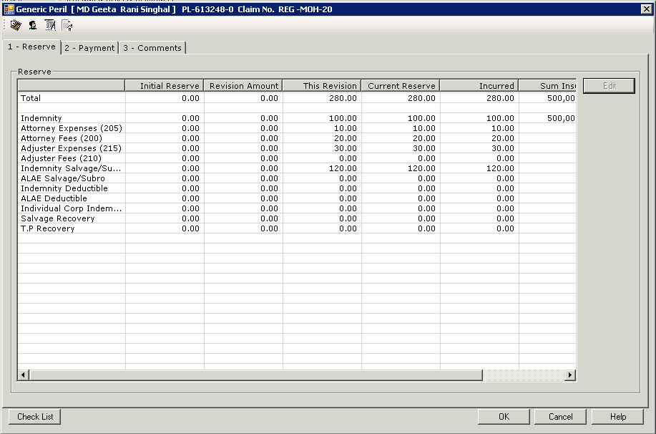
Reserves
Reserves are “estimated totals for the claim”. They are set up during Open Claim and can be revised with Maintain Claim.
Reserve Types are inherited from Policy that the Claim is against.
Reserves determine Reinsurance allocation.

Slide 8
Recovery and Salvage
Recovery of money from third parties in the Claim. E.g.
Insurance company of another driver
Other Party involved
Salvage is the receiving of any other money not handled by Recovery
Scrapping of written off items
Selling of assets

Slide 9
Claim Payments
Claim Payments generate Credits on the Payees account.
User Authority Rules can determine whether a Claim Payment is released immediately or goes through Authorisation.
They are not the actual Payment to the Payee – this is the Cash List Payment.

Slide 10
Claim Receipts
Claim Receipts generate Debits on the Recovery account.
They are not the actual Receipt from the Payee – this is the Cash List Receipt.

Slide 11
Claim Tax
Like all other areas of Sirius, Tax can be applied to Claim Payments and Receipts.
In addition to this, complex tax scripts can also run.
These are currently used by Australia only but can be configured by the customer.
Expect to extend this technology around the system in future releases.

